Slide 1
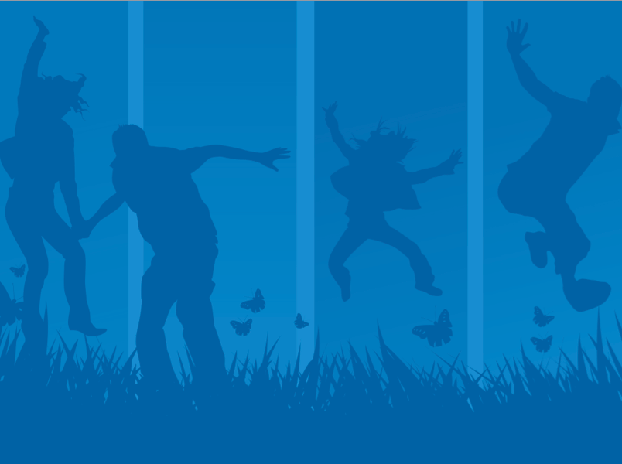

Raising Children’s Mental Health Awareness
April 2014

Slide 2

Mental health conditions in children are a concern
real
One in five children lives with a mental health condition.
50% of mental health conditions start by age 14 and 75% by age 24.
The average delay between onset of symptoms and intervention is 8-10 years.
Only about 50% of youth with mental health conditions receive treatment.

Slide 3

There are to not treating mental health conditions
consequences
Approximately 50% of students aged 14 and older with mental health conditions drop out of high school—the highest dropout rate of any disability group.
70% of youth in state and local juvenile justice systems live with a mental health condition, with at least 20% experiencing severe symptoms.

Slide 4
Serious mental health conditions affect many youth

Slide 5
What can be ?
done
Focus greater attention on early identification and early intervention.
Commit to mental health screenings as part of routine clinical practice.
Ensure that school personnel receive training in the early warning signs and how to link students and families with services.
Educate everyone on the warning signs.

Slide 6
Know the
warning signs
Feeling very sad or withdrawn for more than 2 weeks
(e.g., crying regularly, feeling fatigued, feeling unmotivated).
Seriously trying to harm or kill oneself or making plans to do so.
Severe out-of-control, risk-taking behaviors that can cause harm to self or others.
Sudden overwhelming fear for no reason, sometimes with a racing heart, physical discomfort or fast breathing.
Not eating, throwing up or using laxatives to lose weight; significant weight loss or weight gain.
1
2
3
4
5

Slide 7
Know the
warning signs
6
Severe mood swings that cause problems in relationships.
Repeated use of drugs or alcohol.
Drastic changes in behavior, personality or sleeping habits (e.g. waking up early and acting agitated).
Extreme difficulty in concentrating or staying still that puts a person in physical danger or causes school failure.
Intense worries or fears that get in the way of daily activities like hanging out with friends or going to classes.
7
8
9
10

Slide 8
What to do if you see the warning signs
Parents:
  Talk with your pediatrician or primary care provider.
  Consider an evaluation from a mental health professional.
  Connect with your local NAMI for information and support.
Child-Serving Professionals:
  Talk with the child’s family.
  Help link the family to services and supports.
  Connect the family with the local NAMI.

Slide 9

Suicide is also a real concern in children and youth.

Slide 10
about youth suicide
Facts
Suicide is the 3rd leading cause of death in youth aged 15-24.
90% of youth who die by suicide have a mental health condition.
A high percentage
of high school students
have thought about
suicide:

Slide 11
Know the suicide
warning signs
!
Talking about hopelessness, worthlessness, being a burden to others, feeling trapped or having no reason to live.
Having no motivation or losing interest in activities once enjoyed. Withdrawing or feeling isolated.
Sudden change in personality or behaviors.
Giving away possessions, behaving recklessly.
Talking about death or not being here tomorrow; looking for ways to kill oneself such as searching online or buying a gun.
!
!
!
!

Slide 12
What to do if you see the warning signs
Always take these warning signs seriously.
Take action right away by:
Immediately connecting the child or youth with a mental health professional.
Taking the child to an emergency room.
Calling the National Suicide Hotline for guidance (1-800-273-8255).
The key is to never ignore the warning signs.

Slide 13

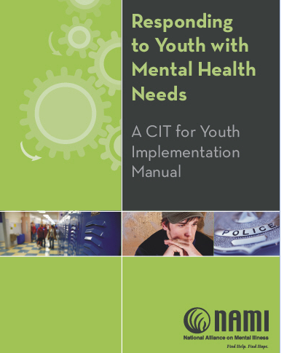

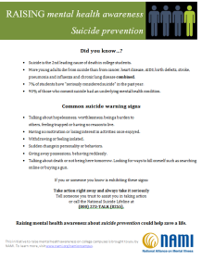
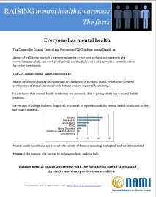
NAMI is here to educate and support families and
child-serving professionals.

Slide 14
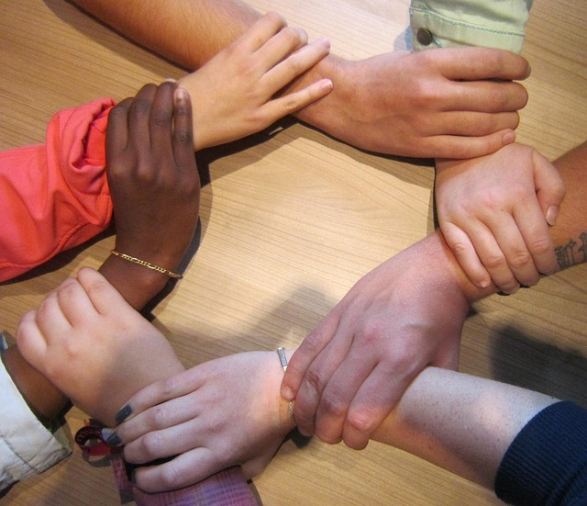
For Families
Educate ● Support ● Advocate
NAMI Basics: an educational program for
parents and caregivers of
children and adolescents
living with mental illnesses.
Support Groups: contact your
local NAMI for information on whether they have groups for families or youth.
Work with your local NAMI on advocacy efforts to improve children’s services in your state and community.

Slide 15

For Schools
Educate ● Support ● Advocate
NAMI Parents and Teachers as Allies : a program for school professionals that covers the early warning signs, how to connect students with services and more.
NAMI Ending the Silence : a classroom presentation for high school students that helps them to better understand mental health conditions.

Slide 16

For Primary Care Providers
Educate ● Support ● Advocate
The Family Experience with Primary Care Physicians and Staff : a national report sharing family experiences with mental health in primary care.
What Families Want from Primary Care : shares how families would like mental health to be addressed in the primary care setting.
Fact Sheet: Start a Conversation about Children’s Mental Health : relates the family perspective on how primary care providers can start a conversation on mental health.

Slide 17

NAMI is here for you
Educating and informing families, youth and child-serving professionals.
Supporting youth and families to ensure they know they are not alone.
Advocating for a broader array of effective services and supports.

Slide 18

Children living with mental health conditions succeed everyday. With the right services and supports, all children can thrive.

Slide 19

For more information, please contact:
Add Presenter’s Name
Add Presenter’s Email
Add Presenter’s Phone Number
Add Website
www.nami.org

